Slide 1
Correlation between “We The People” and Congress
Tim Blazek, Olivia Roy, Andy Shin
Social Sensing and Cyber-Physical Systems
Spring 2019

Slide 2
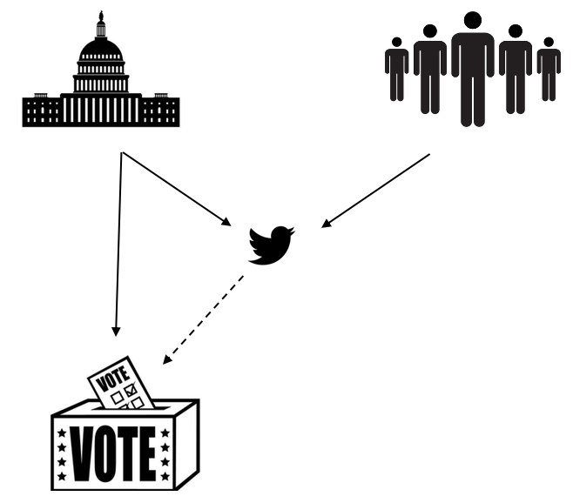
Motivation
Encourage writing and calling to Senators
Tweet political opinions and feelings
Do Senators accurately represent people?
75% of time vote with party

Slide 3
Challenges
Lack of geo-location
Voting on party lines
Amdt. 270 – Vote to repeal Obamacare
July 25, 2017
Sentiment analysis
“Obamacare is death”
"We can do better than Obamacare”
Mapping Twitter user to corresponding Senator

Slide 4
Related Work
From Tweets to Polls: Linking Text Sentiment to Public Opinion Time Series
Every tweet counts? How sentiment analysis of social media can improve our knowledge of citizens' political preferences with an application to Italy and France
Social media in managing political advertising: A study of India
Notes:
From Tweets to Polls: Linking Text Sentiment to Public Opinion Time Series
Compared public opinion from polls to sentiments measured from tweet
Every tweet counts? How sentiment analysis of social media can improve our knowledge of citizens' political preferences with an application to Italy and France
Analyzed voting intentions of users and the subsequent results in the French presidential and legislative elections of 2012
Does public opinion reflect reality of elections?
Social media in managing political advertising: A study of India
Another explored the relationship between tweet follows and shares gained by parties and the Delhi Assembly elections in India in 2015

Slide 5
Methods
GetOldTweets library
Tweets @ Senators
How Senators voted
TextBlob for sentiment analysis

Slide 6
Initial results
43,000 tweets with “Obamacare”
Remove repetitive usernames
Party line negative sentiment
Notes:
Remove users -> 30,000 users. Determined by voting

Slide 7
Upcoming milestones
Create classification sentiment analysis
Justifying the twitter population
Determining if correlation exists

Slide 8
Questions

